Slide 1

Human Pose Estimation
Presented by
Ahmad N. Riza (M10903807), Department of Mechanical Engineering
Jirayu Petchhan (D10907801), Department of Electrical Engineering

Slide 2
Content
Introduction
Dataset and Preprocess Data
Network Architecture
Loss function & Optimizer
Experimental Results
Conclusion and Future Works
Reference

Slide 3
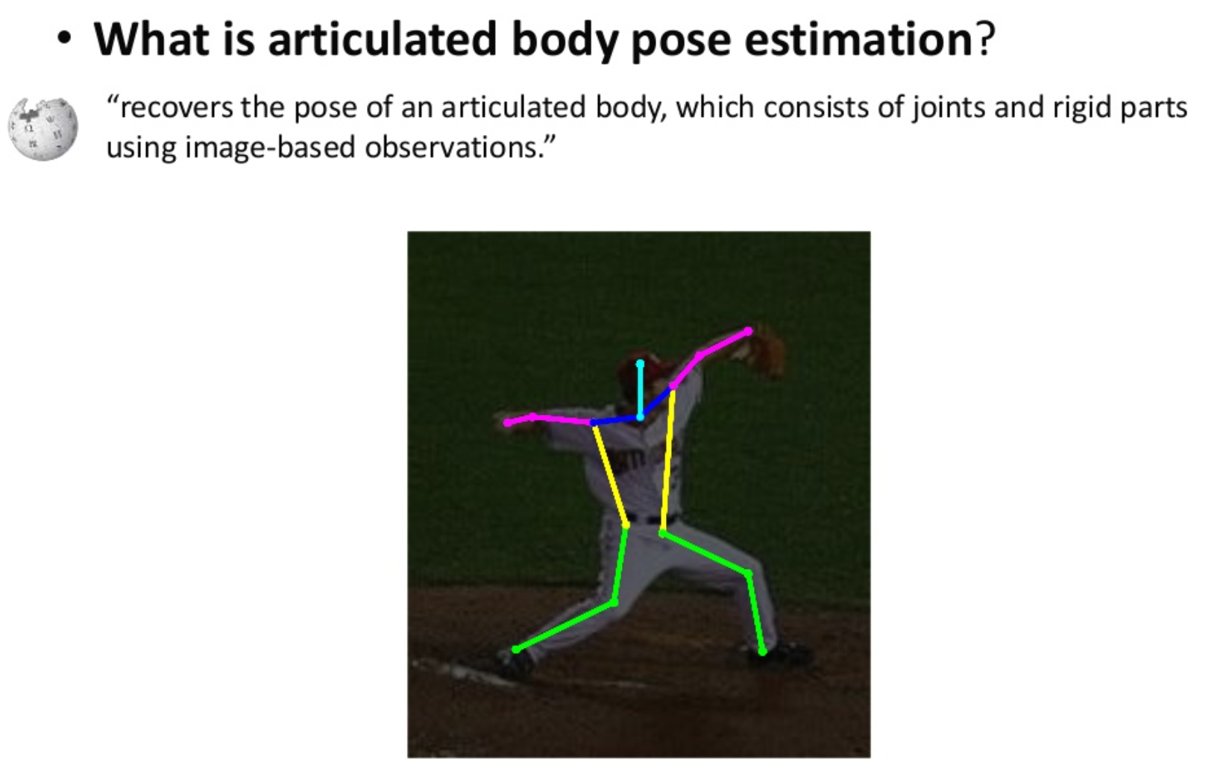

Slide 4
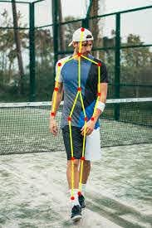
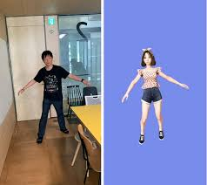
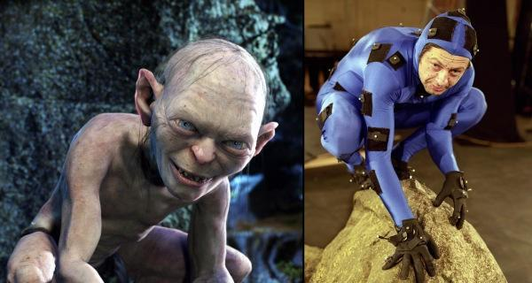
Human Pose Estimation
Defined as the problem of localization of human joints
The main goals is to detect keypoints of human body
Used for motion tracking, action recognition, animation, game, augmented reality, etc.

Slide 5
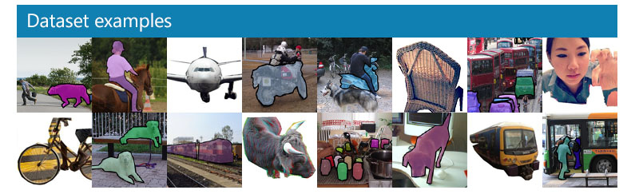

COCO Dataset
The COCO train, validation, and test sets contain more than 200k images and 250k person instances labeled with keypoints.

Slide 6
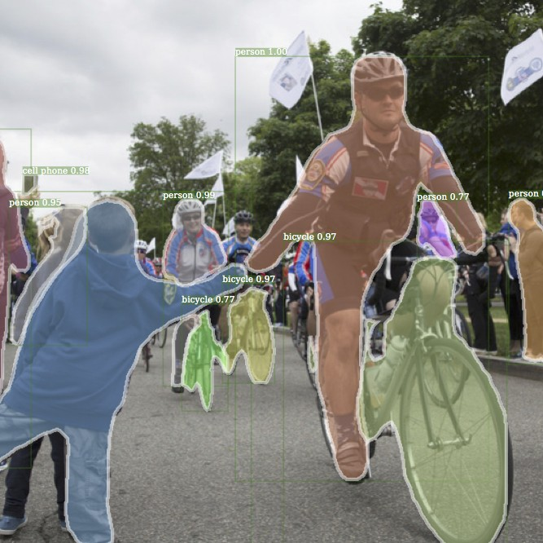
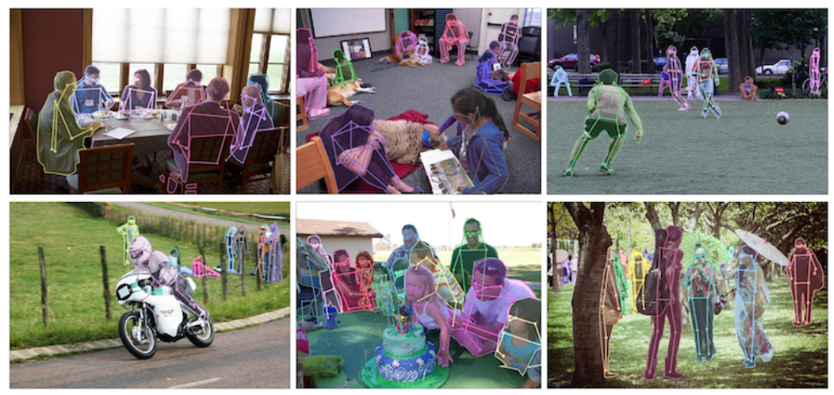
COCO Dataset
The keypoint task involves simultaneously detecting people and localizing their keypoint

Slide 7
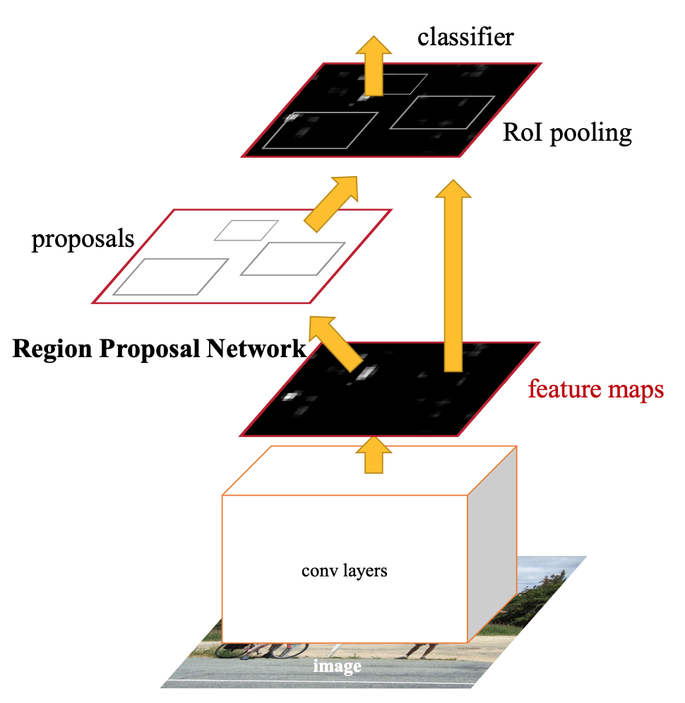
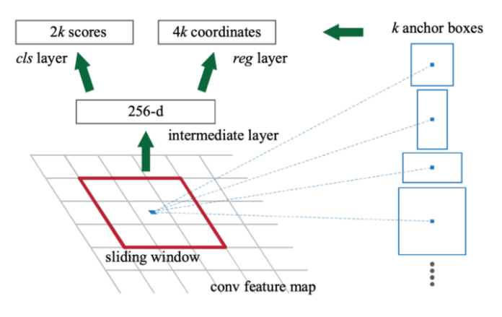
Faster R-CNN
Faster R-CNN consists of the RPN and a Fast R-CNN detector
"the RPN module tells the Fast R-CNN module where to look."

Slide 8
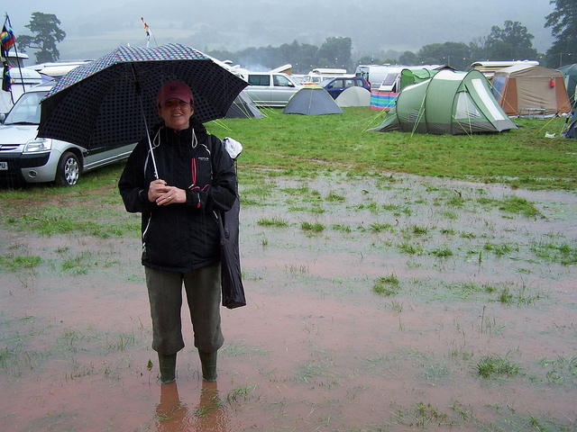
System Flow Diagram
Data Augmentation
Network Architecture
Faster R-CNN
The augmentation data set contain scales(±30%), rotates(±40 degrees) and flip.

Slide 9
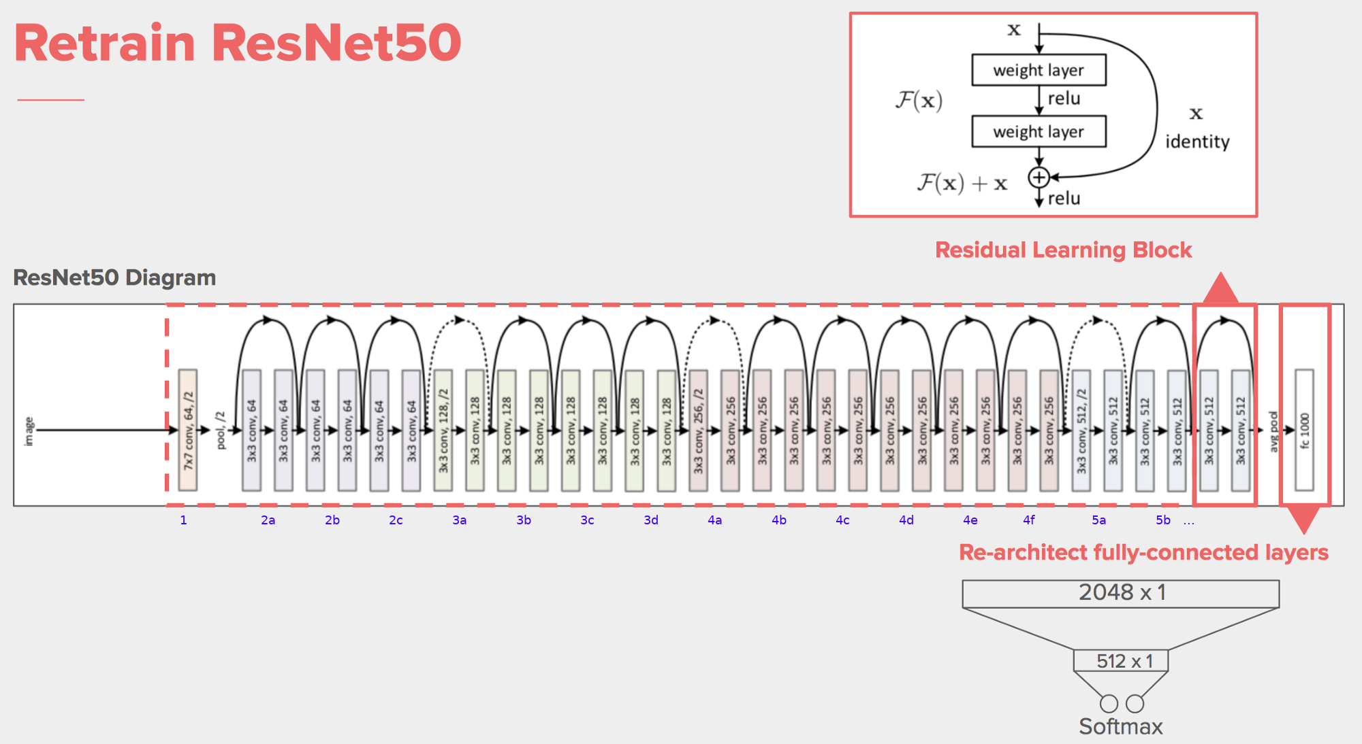
Backbone - ResNet

Slide 10
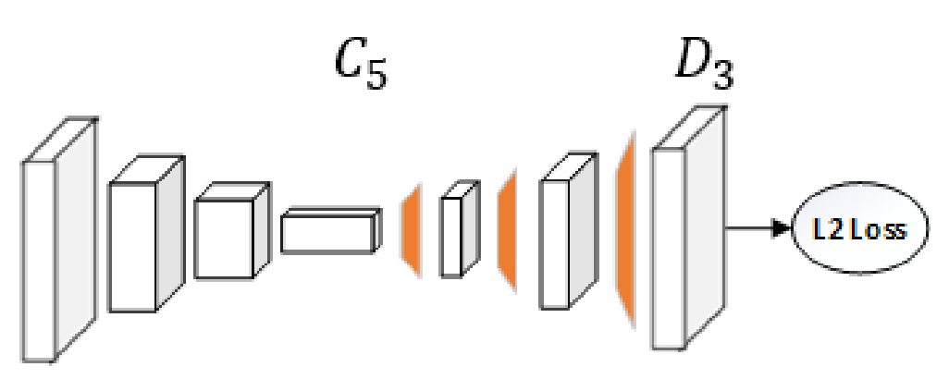
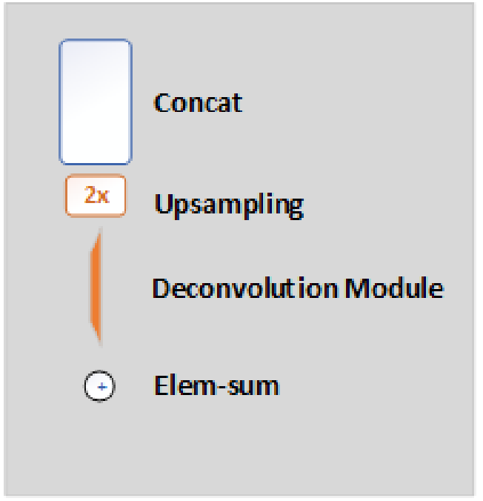
Network Architecture
ResNet
Each deconvolutional layer using (batch normalization, ReLU, f=256, k=4, s=2)
Deconvolutional layer following by 1x1 convolutional layer
Notes:
By default, three convolutional layers with batch normalization and ReLU activation function are used. Each layers has 256 filters with 4 x 4 kernel. The stride is 2. A 1x1 convolutional layer is added at last to generate predicted heatmap {H₁,….H_{k}} for all k key point.

Slide 11
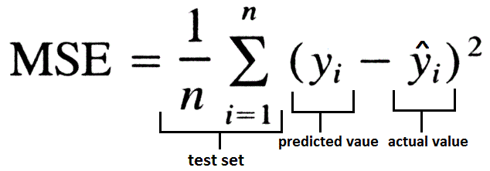
Loss Function & Optimizer
Heatmaps classifier
predicted heatmaps
targeted heatmaps
Loss Function Mean Square Error (MSE)
Optimizer Adaptive Moment Estimation (Adam)
Notes:
MSE is used as the loss between the predicted heatmaps and targeted heatmaps. The targeted heatmaps H_{k} for joint k is generated by applying a 2D gaussian centerd on the k^{th} join’s ground truth location

Slide 12
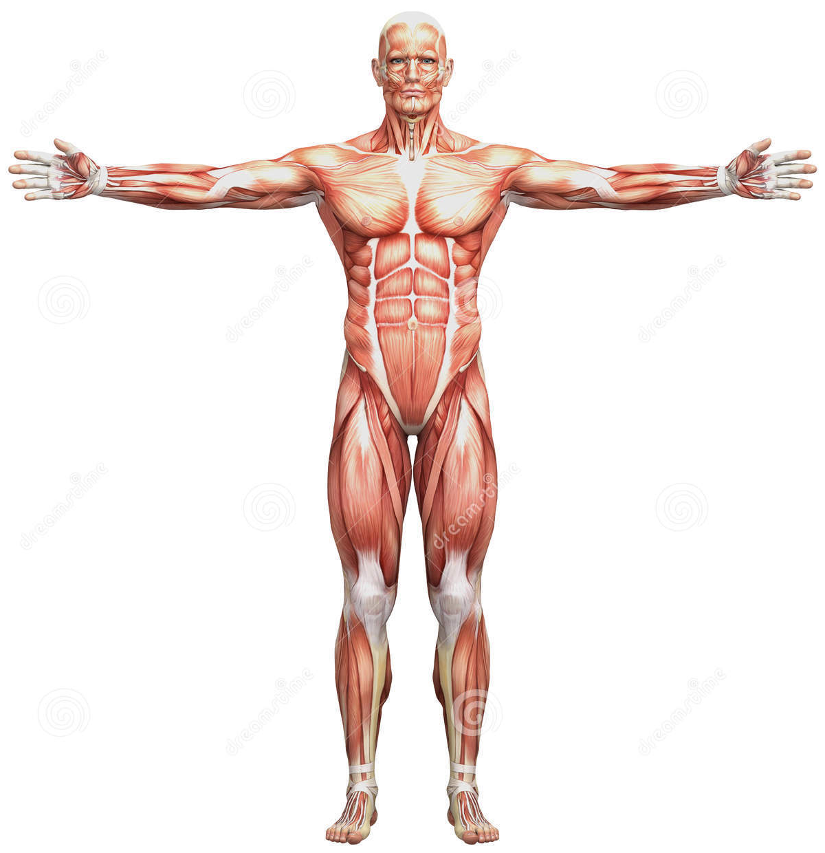
Human Body Keypoints
The keypoint task involves simultaneously detecting people and localizing their keypoint
There are 17 keypoints

Slide 13
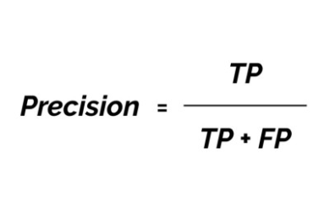
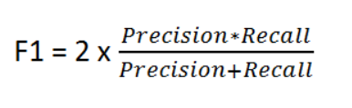
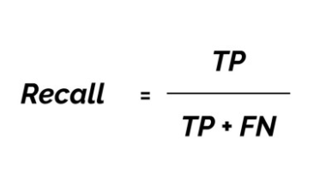
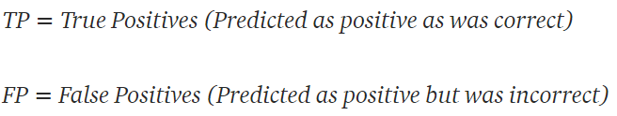
Validation Method
How many selected items are relevant
How many relevant items are selected
F1 is used to seek the balance between precision and recall
Very useful when we have imbalanced classes

Slide 14
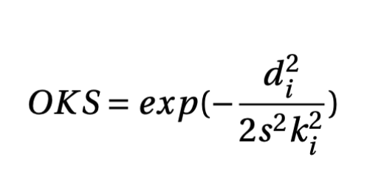
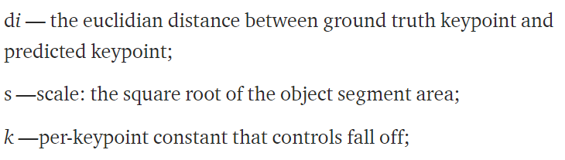
Validation - Object Keypoint Similarity (OKS)
Evaluation metrics that contain of average precision and average recall (similar concept to IoU in object detection)
Used to measure how close the detected keypoint is to the ground truth
The value range is 0 to 1
Common threshold are 0.5 and 0.75
Notes:
The OKS metric shows ONLY how close is predicted keypoint to the true keypoint (value from 0 to 1).

Slide 15
Experimental Setup
Parameters | ResNet50 | ResNet101 | ResNet152
Batch Size | 32 | 50 | 40
Epoch Number | 20 | 20 | 20
Learning Rate | 0.001 | 0.001 | 0.001
Optimizer | adam | adam | adam
Loss Function | MSE | MSE | MSE
Deconvolutional Layer | 3 | 3 | 3
The model is trained by using pretrained model
Batch size is depending on the GPU

Slide 16
Training Result
Model | Heatmaps
ResNet50
ResNet101
ResNet152

Slide 17
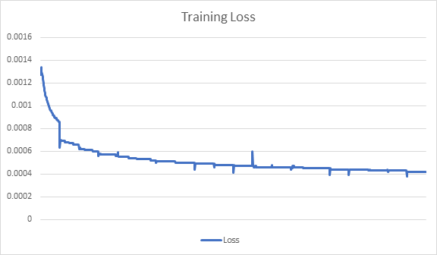
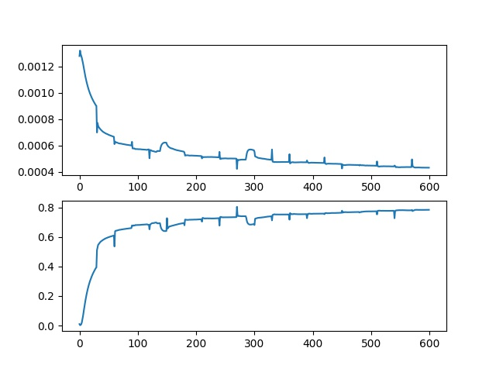
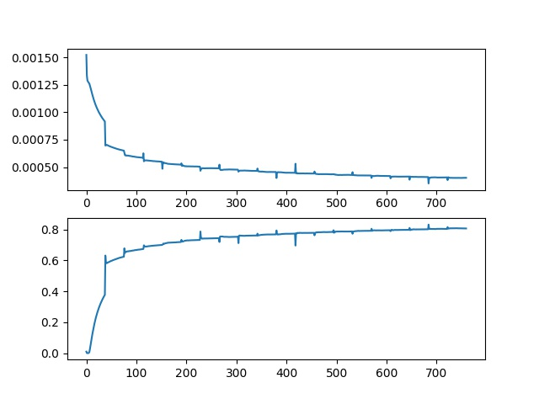
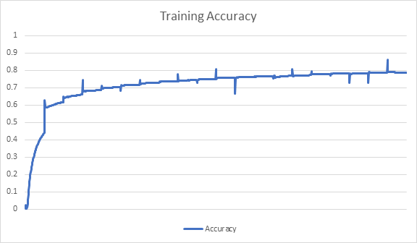
Training Result
ResNet50 | ResNet101 | ResNet152

Slide 18
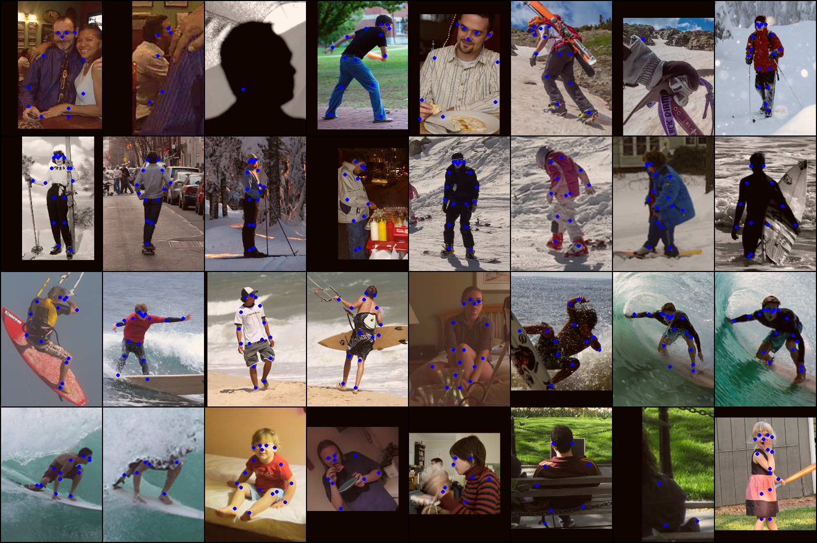


Validation Result
ResNet50
ResNet101
ResNet152
-

Slide 19
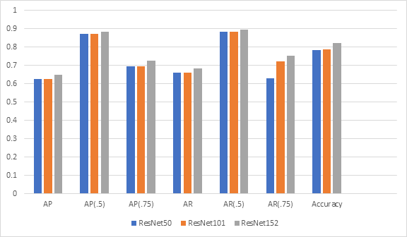
Validation Result
AP = Average Precision
AR = Average Recall
Deeper network given better result

Slide 20
Conclusion
This simple algorithm can predicted the keypoint on the human body very well
The deeper backbone (ResNet) given better accuracy

Slide 21
New Challenge and Future Works
Train the model using MPII dataset
Modify the number of deconvolutional layers
Try to use another backbone model

Slide 22
Reference
https://arxiv.org/abs/1804.06208
https://cocodataset.org/#home
https://github.com/microsoft/human-pose-estimation.pytorch
https://towardsdatascience.com/an-overview-of-resnet-and-its-variants-5281e2f56035
https://towardsdatascience.com/breaking-down-mean-average-precision-map-ae462f623a52

Slide 23


Slide 24
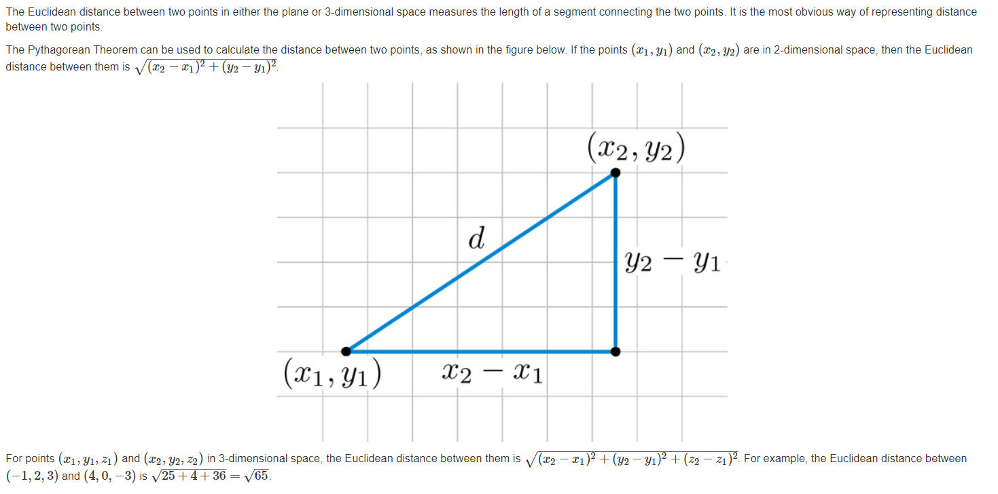
Eucledian Distance

Slide 25
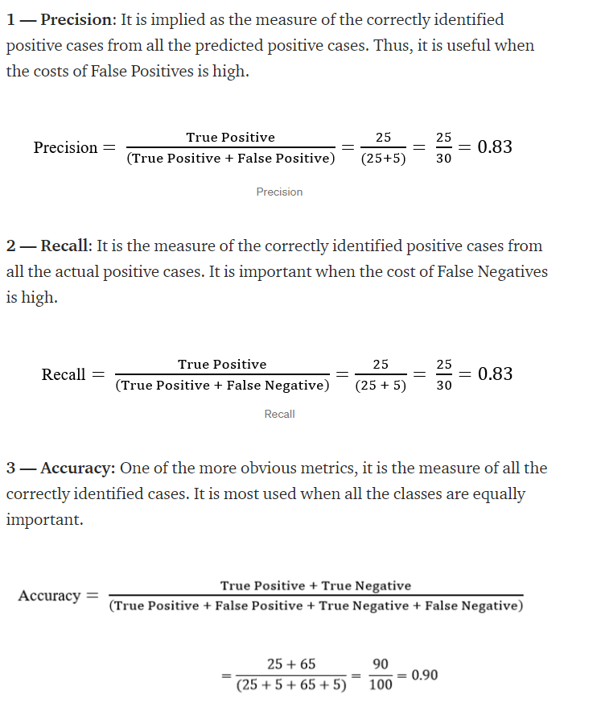
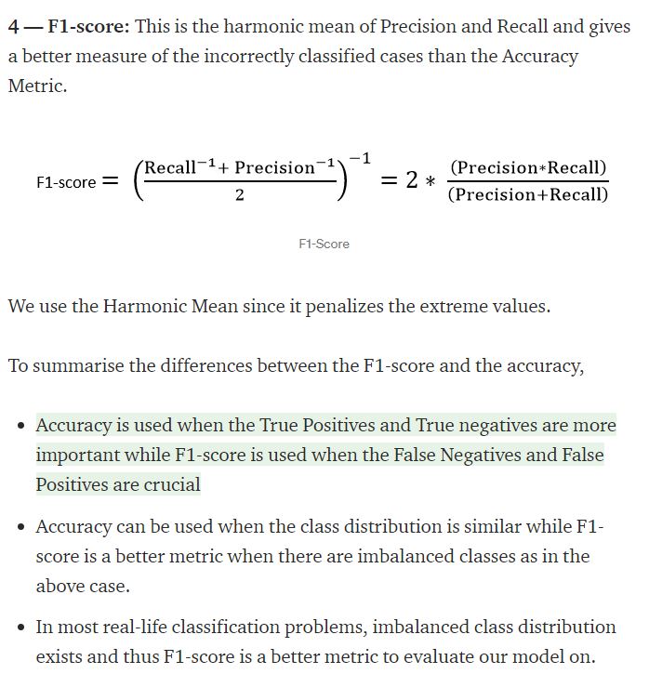
Accuracy Vs F1

Slide 26
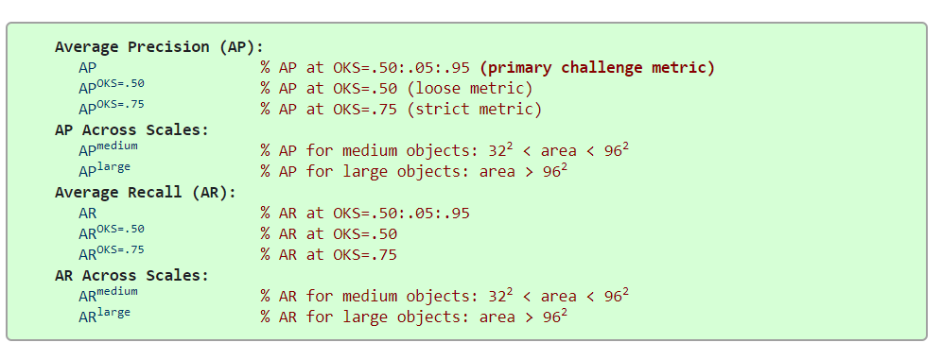
OKS

Slide 27
Validation Result
Model | AP | AP_{.5} | AP_{.75} | AR | AR_{.5} | AP_{.75} | Accuracy
ResNet50 | 0.625 | 0.873 | 0.693 | 0.661 | 0.883 | 0.630 | 0.784
ResNet101 | 0.624 | 0.872 | 0.693 | 0.659 | 0.882 | 0.721 | 0.789
ResNet152 | 0.648 | 0.883 | 0.726 | 0.685 | 0.895 | 0.751 | 0.821
Deeper network given better result

Slide 28
